Slide 1
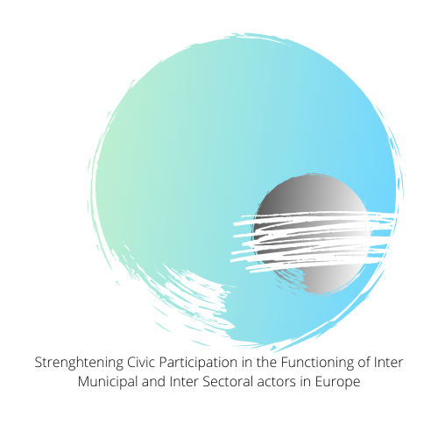
Incoop – Kick off Meeting & Presentation of the Situation of Existing Inter-municipal and Inter-sectoral Actors in Europe.

Slide 2
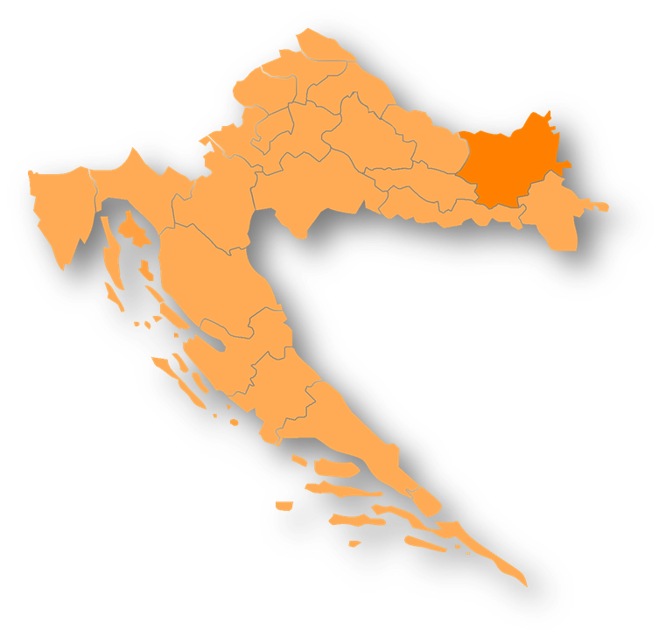
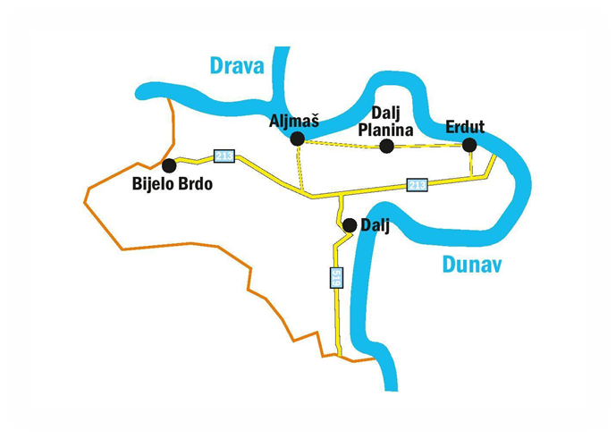
Erdut Municipality
The municipality of Erdut is located in the east of Croatia in Osijek-Baranja County
Established in 1993.
The municipality consists of 4 villages: Erdut, Aljmaš, Bijelo Brdo and Dalj as the municipal center
Multicultural environment (Croats, Serbia and Hungarians): 7.308 inhabitants
Economic basis: agriculture and tourism

Slide 3
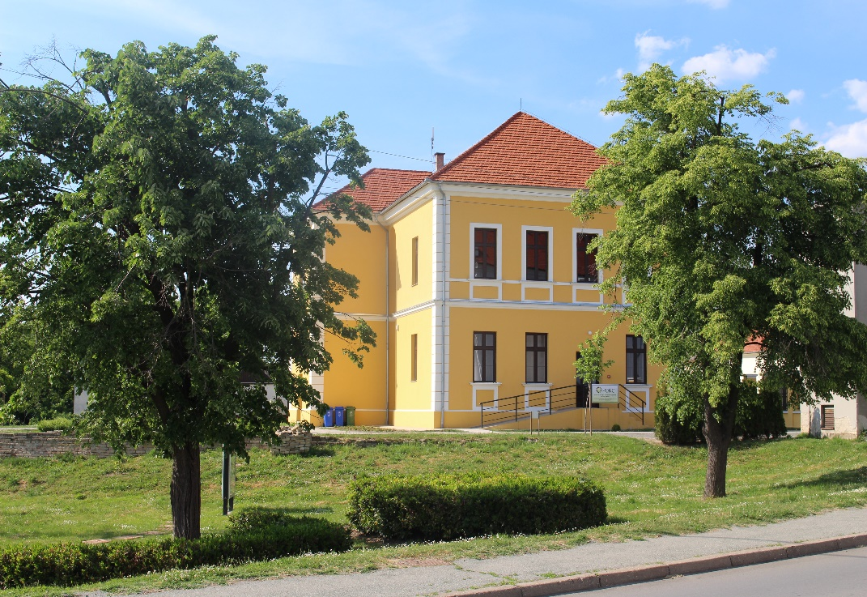
Entrepreneurship development Center of Erdut Municipality Local develop Agency Ltd.
In 2007, the Municipality of Erdut established a support institution, the Entrepreneurship and Development Center of Erdut Municipality
Some of the goals are: promotion and development of local, innovative entrepreneurship with a tendency to strengthen entrepreneurial potential, development of rural area, agriculture and continental tourism, applying knowledge and ensuring higher levels of competencies, strengthening the intensity of cooperation in all fields, and networking
PORC LRA develops and implements projects on behalf and for the municipality of Erdut, and also cooperates with all relevant institutions in Croatia and wider.
some of the services: project writing, project implementation, consulting, education…
some of the projects from the Europe for citizens program: projektu E.W.Y. (Italy) , EU ROADS project (Slovenia) , Achieve (Italy), East-West project….

Slide 4
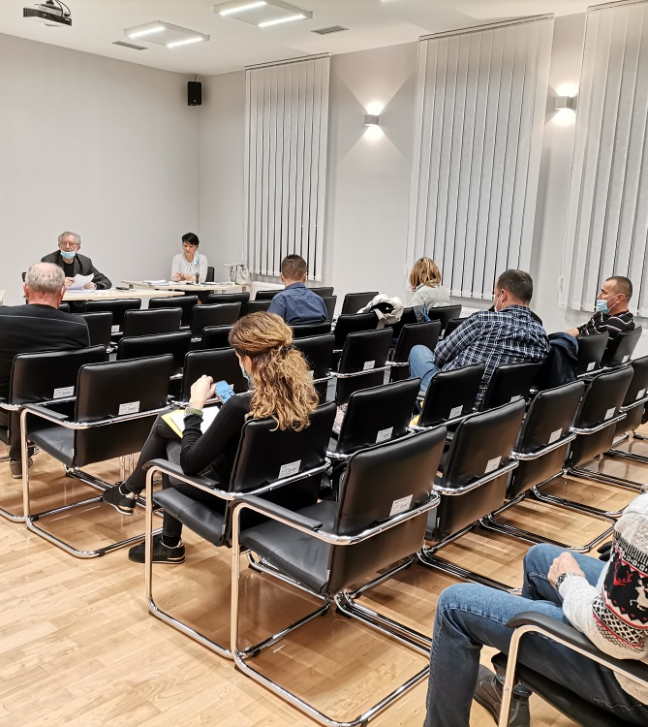
Activities undertaken to involve citizens (participation in policy and budget creation)
The local self-government unit promotes synergy between the citizens of the municipality of Erdut and its employees with continuous adoption of feedback from the community and responses to problem solving.
Citizens directly and indirectly report problems to the Municipality
Direct way - arrival of citizens and addressing professional services according to the appropriate field of work, which receive inquiries and initiate procedures in resolving
Indirectly - addressing citizens through social networks, thematic shows, TV, local radio,..

Slide 5
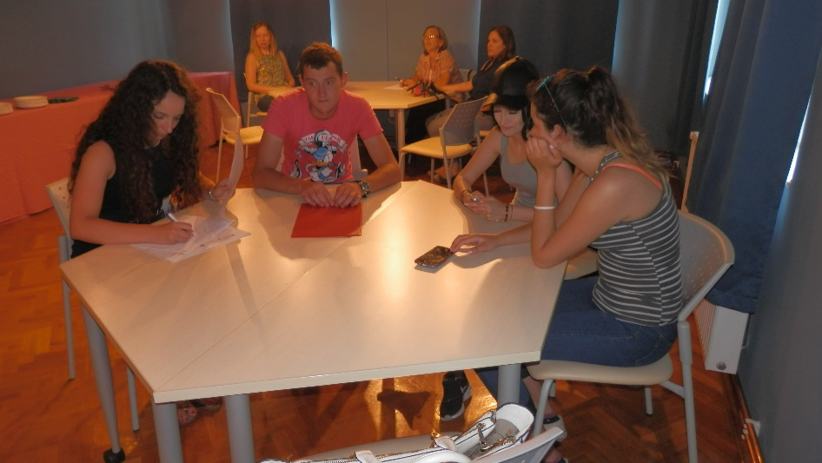
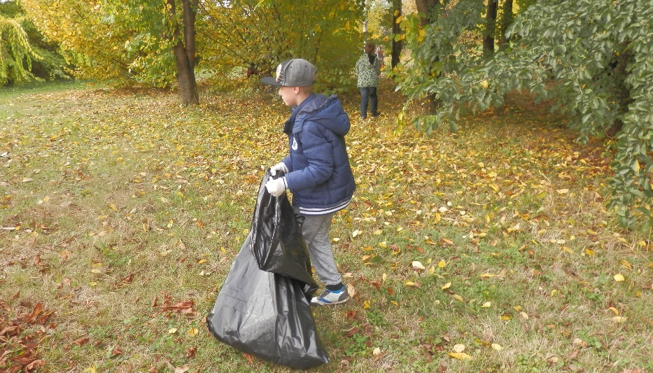
The Municipality of Erdut promotes social policy (socially responsible behavior), work with volunteers, environmental protection policy, energy efficiency policy ...
Social policy - care for the old people
Volunteers - The municipality promotes volunteer work and active participation of volunteers in all community activities.
Through the volunteer base it owns, they create the human resources needed for various activities (landscaping, helping the elderly and the socially disadvantagedaktivnosti vezane za vandredne situacije-pandemije ...) Volunteers also participate in soft activities (seminars, workshops ..
Environmental protection - through synergistic action of the Municipality and the local population refers to solving an important problem, illegal landfills and increasing waste. The local population together with the Municipality is working on waste sorting activities (recycling yard "Studenac"

Slide 6
The main benefits of the Municipality as a participant are networking with the same or similar stakeholders of this project and transferring examples of good practice between different areas.
By connecting with the participants in the project, the Municipality plans to strengthen its own human capacities, the local population, and create a stimulating environment for new initiatives.
By connecting the participants, preconditions are created for its sustainability, ie the continuation of cooperation after the implementation of the project, related to potential initiatives in the future.
These project activities act as a starting point for the development of existing and the creation of new policy at the local level.

Slide 7
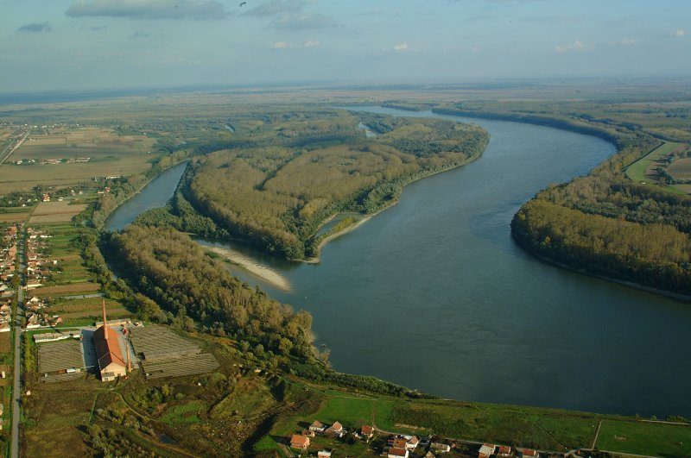
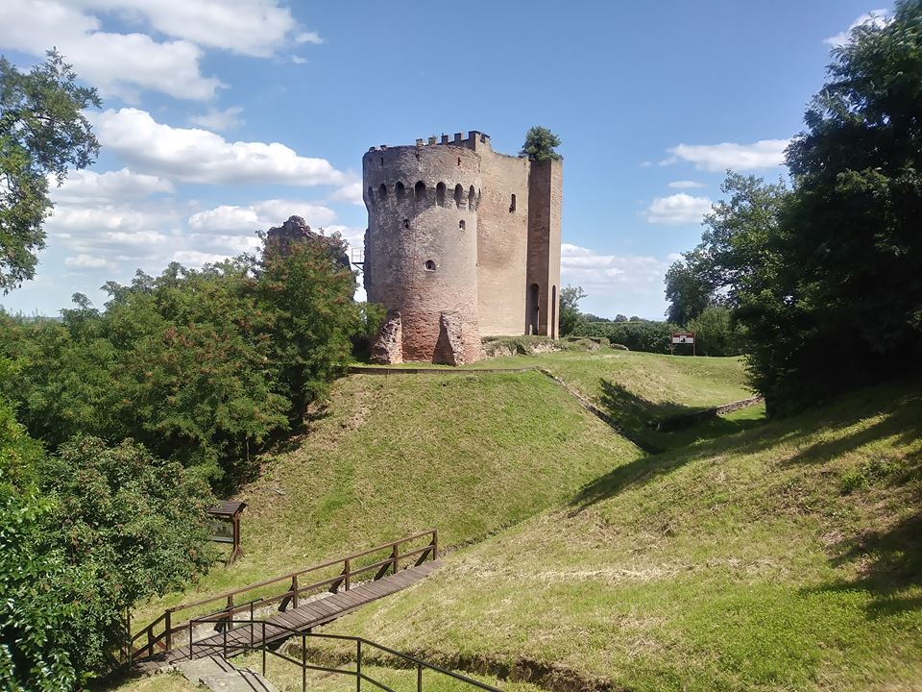
THANK YOU!
Erdut Municipality

