Slide 1
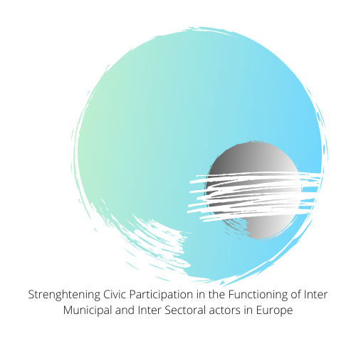
Incoop – Kick off Meeting & Presentation of the Situation of Existing Inter-municipal and Inter-sectoral Actors in Europe.

Slide 2
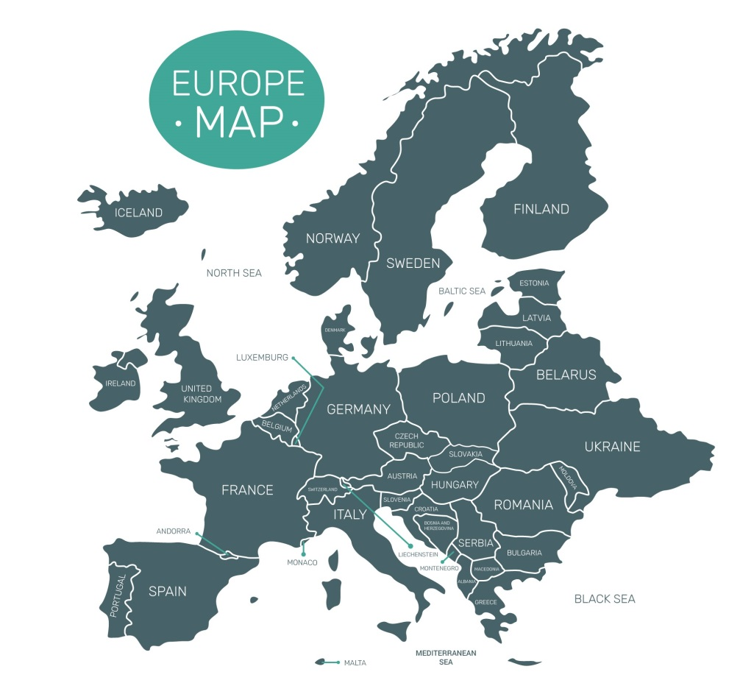
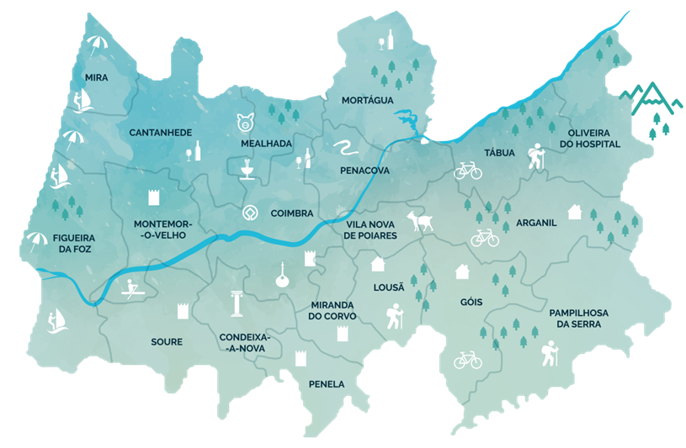
Intermunicipal Comunity of Coimbra Region (CIM RC)
Inter-municipal entity - Associative nature
Territorial scope: 19 municipalities
4.336 km² - Centre of Portugal - from the Atlantic Ocean coast to the highest mountains of Portugal
Resident population: 460,000 inhabitants
Coimbra Region - Different geographic and social characteristics

Slide 3
CIM RC – Scope and Goals
Promoting economic, social and environmental development
Linking municipal investments of intermunicipal interest
Participation in the management of Regional Development Programmes
Planning public authorities actions, other than local government
Join efforts to make the Coimbra Region a more balanced territory, with greater social cohesion, by diminishing asymmetries and inequalities in our territory

Slide 4
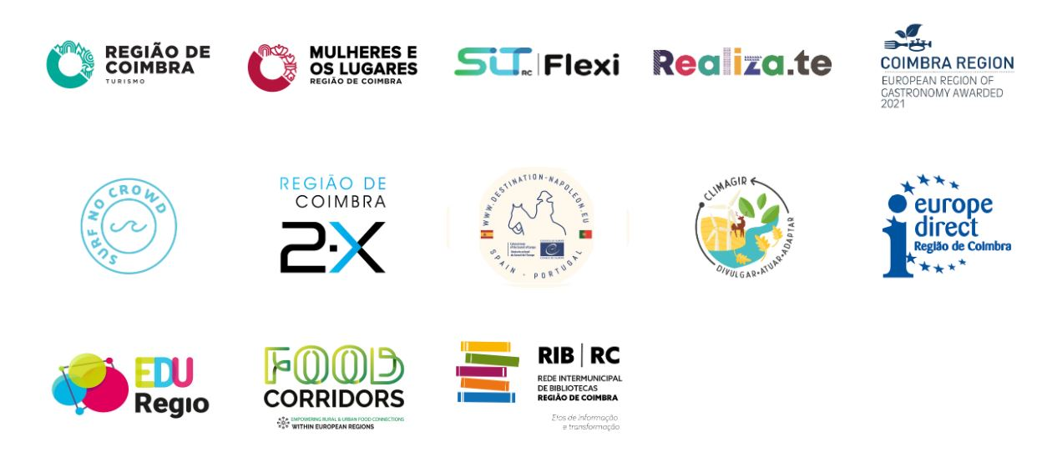
CIM RC Activities
https://www.cim-regiaodecoimbra.pt/en/home-2/
Notes:
The activities promoted by the CIM are in several areas, from culture, environment, education, and transportation.
For example:
The cultural network formed under the project Coimbra Region of Culture, Women and Places, which includes the municipalities of CIM Região de Coimbra, higher education entities, entities responsible for culture and tourism, associations of tour operators and hoteliers, among others, will last for 18 months, during which it will promote cultural initiatives in order to boost and enhance the cultural heritage, shared geographically under the theme "Women and Places of Coimbra Region" - common denominator - in order to position this territory as a unique, creative and attractive destination for cultural tourism.
Realiza.te is a territorial action program that aims to promote school success, social equity, employment and equal opportunities for young people.T he project is aimed at all Public Schools of the 19 municipalities of the Coimbra Region, from students, teachers, parents, non-teaching staff, among others and aims to reduce failure and early school leaving by 10% .
Europe Direct Information Center:
aim to inform European citizens at local and regional level about the EU, referring them to specialised information sources and other services and networks. This information can cover the rights of EU citizens, the EU’s priorities, legislation, policies, programmes and funding opportunities. EDIC also organise conferences and events and channel citizens' feedback to the EU.
FOOD CORRIDORS encourages the creation of a network of cities committed to the design of food plans that extend from the urban and peri-urban areas through a corridor that facilitates an urban-rural connection. This approach enhances the generation of production and consumption environments founded on a base of economic, social and environmental sustainability.
Flexible Transport on Demand is a public transport service where the passenger can book his trip in advance.
The objective of the NAPOCTEP project is to enhance the cultural heritage of the Napoleonic era through the creation of routes in the area that covers the Central Region of Portugal (Beira and Serra da Estela) and the western Spanish provinces of Salamanca, Zamora, Valladolid, León and Avila, creating an innovative and attractive tourist product which generates economic activity and employment.
The ClimAgir Project aims to raise the general public's awareness to the consequences of climate change in the Coimbra Region and, at the same time, to foster autochthonous forest and arises from the preparation of the Intermunicipal Plan of Adaptation to Climate Change that identified this initiative as structuring to raise awareness and prepare the population for the scenarios predicted for the Region in the different sectors of of activities.

Slide 5
Expectations from INCOOP
Exchange of best practices with peers from other contexts and countries with the aim to increase civic participation
Create a network of organisations with similar interests for future collaboration opportunities on local/regional development.

