Slide 1
Incoop – Kick off Meeting & Presentation of the Situation of Existing Inter-municipal and Inter-sectoral Actors in Europe.

Slide 2
Microregion 11+
Established in 2012 It is an interest association of legal entities, which consists of 15 municipalities. Together is has more than 27k citizens.
11+ focuses on co-operation in the field of tourism and regional development based on partnership (public entities, private and third sector institutions)
11+ is connecting actors in the region, increasing citizens participation in activates in microregion.
Notes:
The Cluster of Regional Development is a small, dynamic organization that is focused towards supporting its members and work towards the empowerment of our local communities. We don´t have a broad administrative structure, instead we network with its members and other stakeholders to manages the exchange of experience in their real needs, especially in creating and processing strategies, advising on the preparation and implementation of project objectives of its members, creating conditions for more successful promotion and dissemination of good practice results of our members.

Slide 3
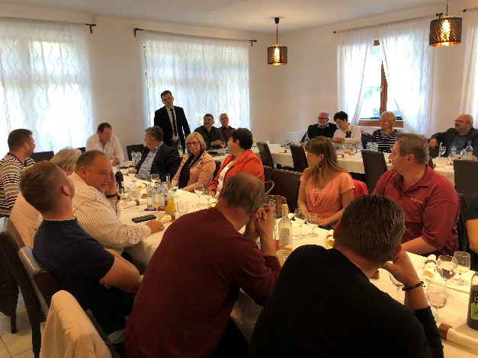
11+ Activities
Organization of cultural, sporting and social events
Organization of excursions and business trips
Organization of workshops and presentations
Participation in domestic and international exhibitions and fairs
Implementation of project activities in the micro-region
Notes:
Flexible Up-skilling pathways for professionals in the field of tourism is a project in the field of adult education, co-funded by the Erasmus+ programme. The project is led US and four partner organisations from Spain, Greece, Italy. The project has a double aim: on one hand, to identify the skills and competences gaps in the tourism sector and on the other, to promote flexible up-skilling pathways for professionals in the tourism sector and provide them with an appealing and interactive programme that will combine the use of technology with flexible learning environments. We are implementing this now, and so far we have involved both private and public organisations such as municipalities, offices of tourism promotion, tourists, etc. The final results will be accesible through the Project website.

Slide 4
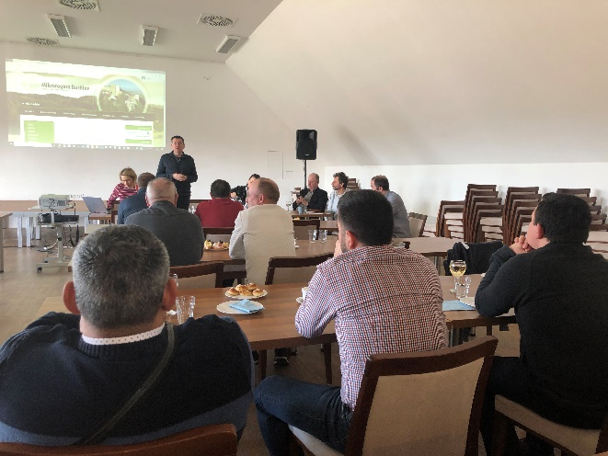
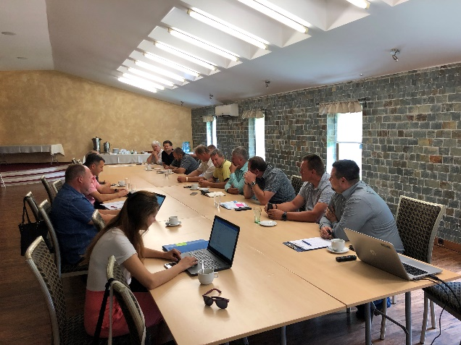
11+ Activities II
Networking with other micro-regions in Slovakia and abroad
Participation in international projects
Ensuring the exchange of experience at professional seminars and meetings
Creation of joint strategic projects
Notes:
Note to slide 1: examples of events: Village Days, Annual General Celebrations, Memorial Days, Constitution Day, Thematic Events, Celebrations with Celebrities, Festivals and others. They also include lectures and speeches by invited guests and discussions on current social topics.
Note to slide 2: For example: digital game developed on the occasion of the Slovak Presidency of the Council of the EU, when the cluster created a series of competitions at several secondary schools in the Trnava region aimed at testing students' knowledge of the European Union and European policies. Several competition teams were created at each school and the best ones advanced to the semifinals and finals. The game was implemented via the web, the questions were answered by choosing from options a), b), c), d). After the end of the competition, the game was of interest to the general public for several more months, and they could play this game outside the official competition.
Note to slide 3: It is often also about the involvement of citizens in what is happening in municipalities, cities. Examples are given of how citizens have been involved, for example, in their participation in draft participatory budgets, but also in specific activities - such as personal participation in discussions, thematic events, excursions, etc., comparing the level of effort required to activate a certain group of citizens. compared to another group and the like. A successfully organized activity, such as a discussion with a personality of cultural, social or political life, is usually repeated elsewhere but with a similar or the same content focus, as the level of interest and success can already be assumed on the basis of past experience.

Slide 5
Expectations from INCOOP
Exchange of best practices with peers from other contexts with the aim to increase civic participation.
Create a NETWORK of organisations with similar interests for future collaboration opportunities on local/regional development.

